Slide 1
Endotracheal Intubation: trouble shoot and complication

Slide 2
Objective
Endotracheal tube in the right main bronchus
Endotracheal tube in esophagus
Associated complications during intubation and their prevention

Slide 3
Tube in Rt. Main bronchus
Breath sounds only on right chest
No air heard entering stomach
No gastric distention
Action:
Withdraw the tube
Recheck

Slide 4
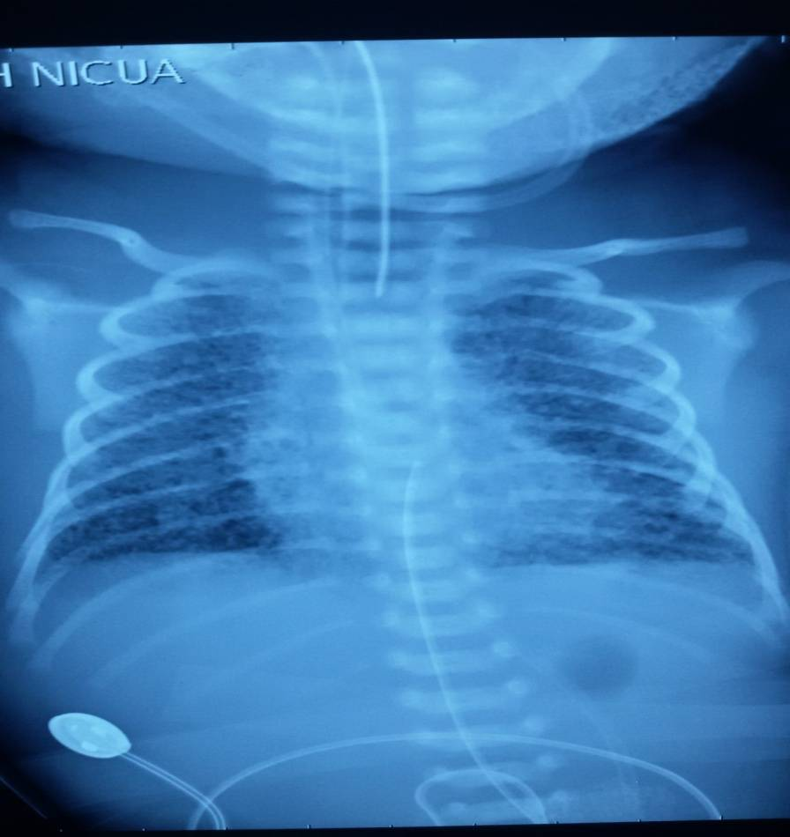
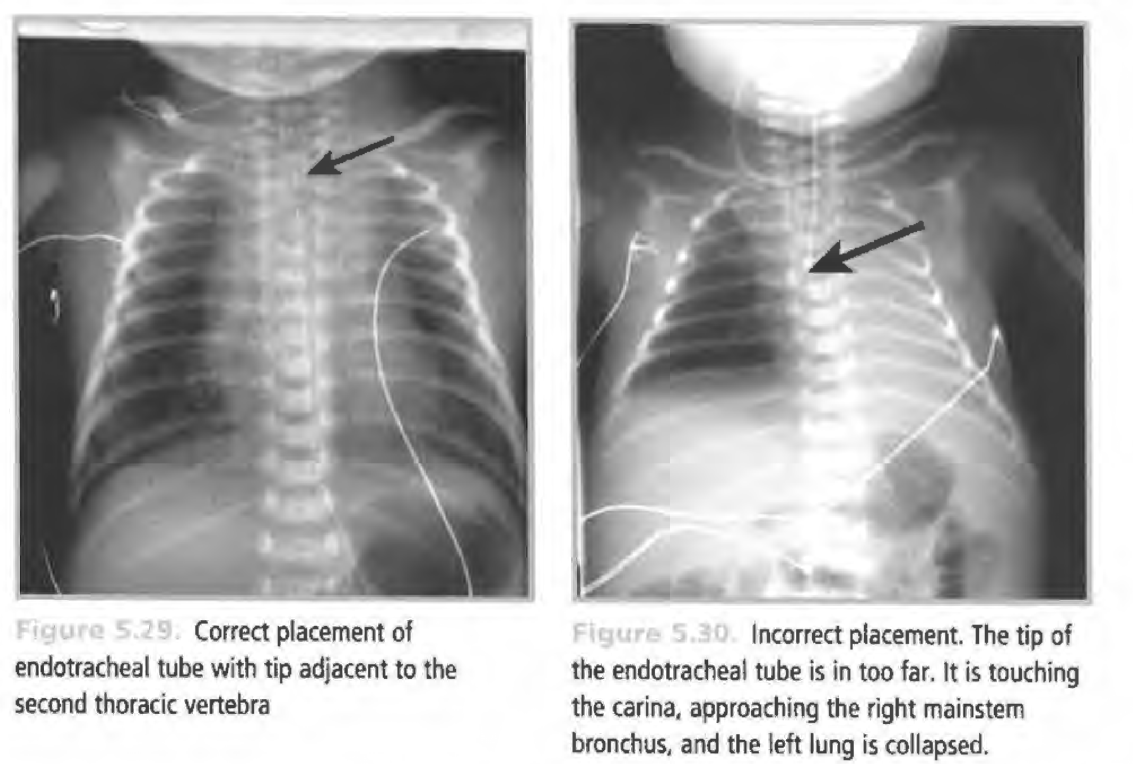
Correct Placement of Tube
Correct placement
of endotracheal tube
with tip adjacent
to the
second thoracic
vertebra
Incorrect placement. The tip of
the endotracheal tube is in too far. It is touching the carina. approaching the right main stem bronchus, and the left lung is collapsed.

Slide 5
Tube in Esophagus
No breath sounds heard
Air heard entering stomach
Gastric distention may be seen
No mist in tube
No CO₂ in exhaled air
Action :
Remove the tube
Bag and mask ventilation
Reintroduce ET tube

Slide 6
Complications During Intubation
Complication | Possible cause | Prevention or corrective steps
Hypoxia | Taking too long to intubate Incorrect tube placement | Ventilate with mask if possible Halt intubation attempt after 30 seconds Reposition tube
Bradycardia/ apnea | Hypoxia Vagal response from laryngoscope or suction catheter | Ventilate with mask if possible Oxygenate after intubation Limit duration of intubation attempts Monitor with pulse oximeter
Pneumothorax | Over ventilate of one lung because of tube in right main bronchus Excessive pressure | Place tube correctly Use appropriate pressures
Contusions or lacerations of tongue | Rough handling of the laryngoscope Laryngoscope blade too long | Be gentle while manipulating the laryngoscope Have proper equipment
Infection | Introduction of infection from hands or instruments | Pay careful attention to clean technique

Slide 7
What we learnt
How to manage complications during intubation.
We should also note that intubation should be done under monitoring with pulse oximeter.
Size of endotracheal tube and depth of insertion should be determined before procedure, so that complication are prevented or detected on time.

